Slide 1
Waste Food Management & Donation System

Slide 2
Background/ Problem Statement
A drastic increase can be seen in food waste. As per data given by Food and Agriculture Organization, 1/3rd of food produced for human consumption is wasted globally, which accounts for almost 1.3 billion tons per year. On the other hand, also as per WHO 20% of the population face extreme food shortages. Hence there is a need to come up with a solution that can avoid food waste & can help feed the needy.
This Waste Food Management system can assist in collecting the leftover food from hotels & restaurants to distribute among those in need. NGOs that are helping poor communities to battle against starvation & malnutrition can raise a request for food supply from restaurants through this website. Once the request is accepted, the NGOs can collect the food from the restaurants for its distribution. In this way this food waste management system will help restaurants to reduce food waste and will help in feeding the poor and needy people.

Slide 3
Working of the Project
In this system, we have tried to reduce restaurant food wastage by giving waste food to NGOs. NGOs will raise a request, in case of any leftover food restaurants have. This request is sent to the restaurant manager of that particular restaurant. The NGO Manager then approves the request and assigns it to one of the NGO employees for takeaway and forwards the request to the restaurant or we could partner with the delivery partners who would help in delivering the left over food thereby increasing their Corporate Social Responsibility. The leftover food at the restaurant can be given to NGOs at the end of the day. The admin can track the history of restaurants and NGOs for the leftover foods.

Slide 4
Advantages
Benefits will be both the restaurant (reducing food wastage), and the needy
Since this is going to be a social work we can’t really expect any economic benefits but this project could help the society by feeding the hungry.
We can come up with many donation camps and programs.

Slide 5
System Description
The system comprises of 4 major modules with their sub-modules as follows:
Admin:
1. Register: User can register using personal details.
2. Login: User can login in his personal account using id and password.
3. Restaurant:
• List restaurant: List all the restaurants available
• Add/Register New Restaurant
4. NGOs:
• View All NGOs
• Add/Register New NGOs

Slide 6
Restaurant:
Register: User can register using personal details.
Login: User can login in his personal account using id and password.
Profile:
View Profile/Restaurant details
Change Password
History:
View Orders history
Accepted
Pending
Confirm
Food:
Add new food items to restaurant

Slide 7
NGOs:
Register: User can register using personal details.
Login: User can login in his personal account using id and password.
Details:
View restaurant requests
Add Request:
Request food for NGOs from restaurant
Records:
View restaurant history
Profile:
View Profile/Restaurant details
Change Password

Slide 8
Functional Requirements
It will register all the NGOs and the restaurants, banquet halls, mess etc. of a city in its database.
Sorting will be done according to the distance from respective NGOs.
Notify the NGOs about the restaurants, banquet halls where some event is going to be organized.
Provide with a rough estimation of the amount of the surplus food, once number of guests has been fetched.
People conducting events can also donate when gets in touch with certain centers.
If the user forgets to fetch the number of guests around a certain time (say 11:00pm), it will send a notification to that specific kitchen.

Slide 9
Non Functional Requirements
Since, this is an NGO work, there would be a need of funds for workspace setup.
Sanctioning of our project with government organizations in order to access funds reserved for NGOs.
A simple to use and user-friendly UI is a necessity. Promotion and spreading of the motive is necessary in order to encourage people to raise funds

Slide 10
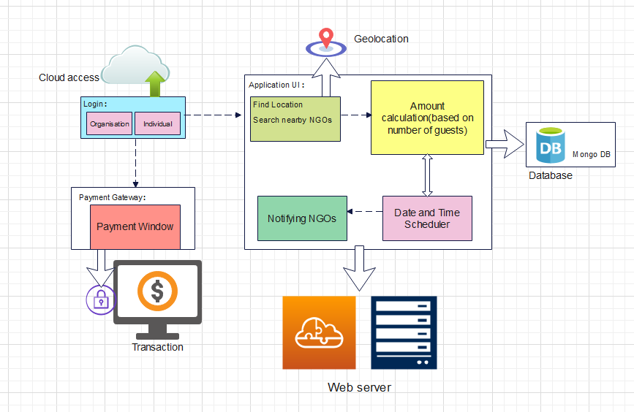
Architecture Diagram

Slide 11
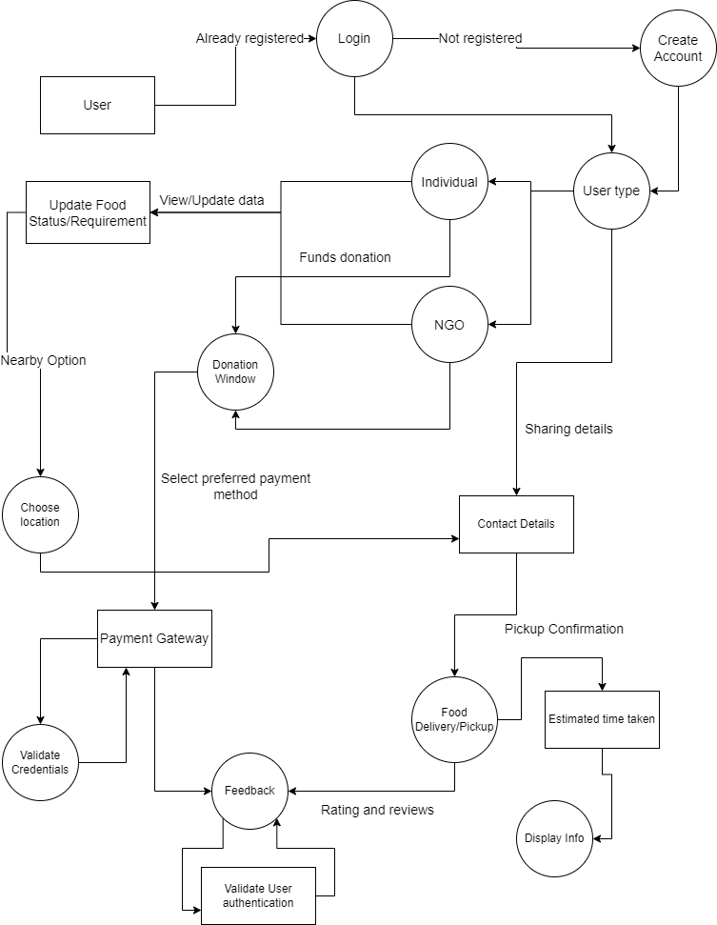
Data Flow Diagram

Slide 12
Functional Test cases
Test ID (#) | Test Scenario | Test Case | Execution Steps | Expected Outcome | Actual Outcome | Status | Remarks
1 | Verify Donor and User Registration from India | Accept Valid Indian Mobile Number on the Page#1 | User clicks on User Registration link Enter the mobile Number on the text box Click Register button | User should be taken to the next page for entering more user details |  | Pass / Failure | success
2 | Login Credentials and Verification | 1.Check Customer Login with valid Data 2. Check Customer Login with invalid Data | Go to site Enter User-Id Enter Password Click Submit Go to site Enter User-Id Enter Password Click Submit | User should Login into an application User should not Login into an application | User has Logged-in the application | Pass | Success
3 | Food Availability Verification | 1.Food Availability 2.Food Unavailability | 1.Check if surplus food is available 2.Verify | Food must be Available | Food is Available | Pass | Success
4 | Order Place Verification |  | 1.Request for Surplus Food 2.Receive Order | Orders should get accepted | Orders are accepted | Pass | Success
5 | Delivery Completion Verification | Minimum to NIL Server Traffic while receiving order | 1.Receive order 2.Confirm Order 3.Prepare Order 4.Out for Delivery 5.Deliver | Food should get delivered | Food is delivered successfully | Pass | Success

Slide 13
Non Functional Test cases
Test ID (#) | Test Scenario | Test Case | Execution Steps | Expected Outcome | Actual Outcome | Status | Remarks
1 | Load Testing | Performance of the application under maximum load | Functionalities of the application are run over a long period of time under maximum load to check degradation | Functionalities continue to run at optimum levels | Functionalities kept running at the optimum level | Pass | Success
2 | Performance Testing | All the operations are working | 1. Each operation in the software is executed at least once 2. The features are tested for proper execution | Operations are able to execute properly | Operations executed properly | Pass | Success
3 | Security Testing | To check for Hackers, Intruders and Robots | 1.Create a Captcha Audio/Visual for Robot Check 2.Encrpyted Transaction | Execute Safe, Secure and Protected Processing | Safe and Secure Execution | Pass | Success
4 | Usability Testing | Ease of use of the application (User Friendliness) | 5 testers are chosen at random and are assigned to complete tasks on the application in-front of the developing team, which monitors the testers behaviours and expressions and evaluates the outcome accordingly | The application is user friendly and easy to use. The controls and jargons are self -explanatory | The application is user friendly, aesthetically pleasing and easy to use. | Pass | Success

Slide 14
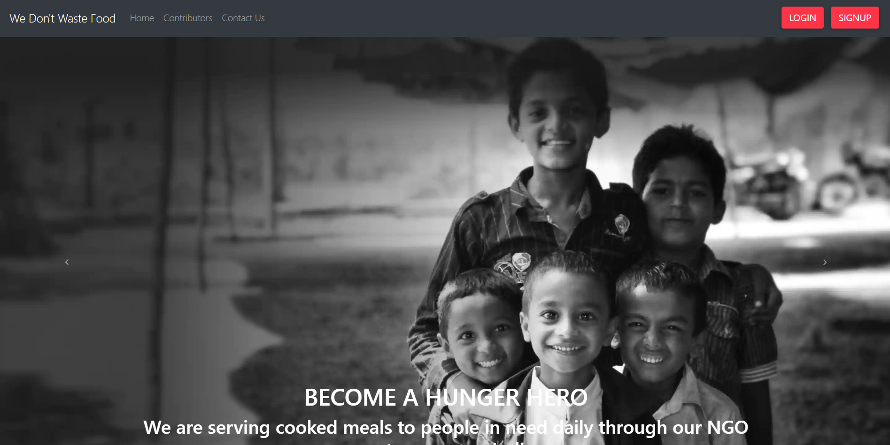
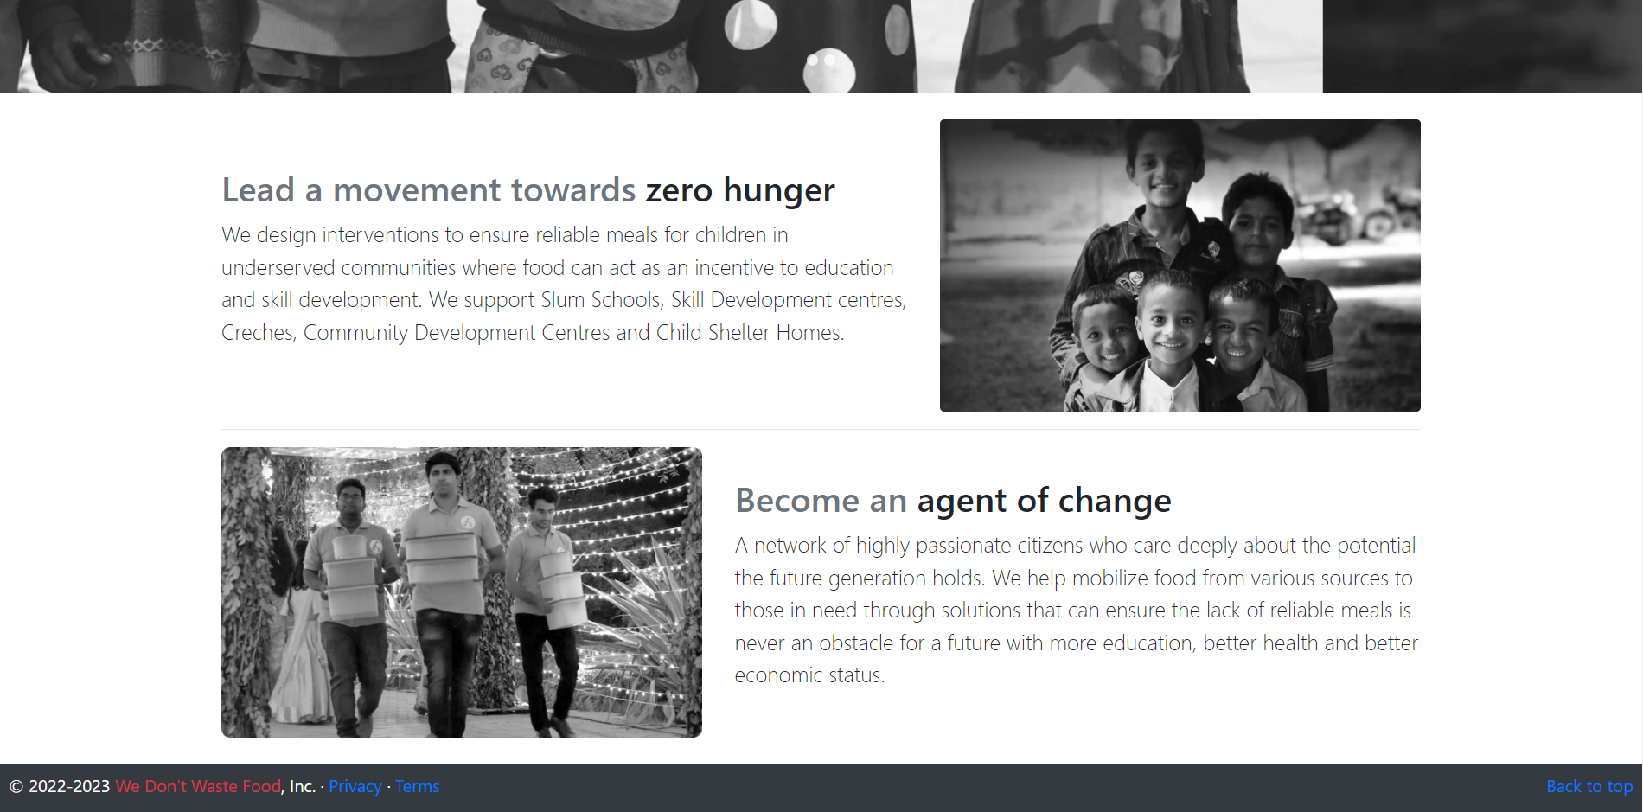

Slide 15
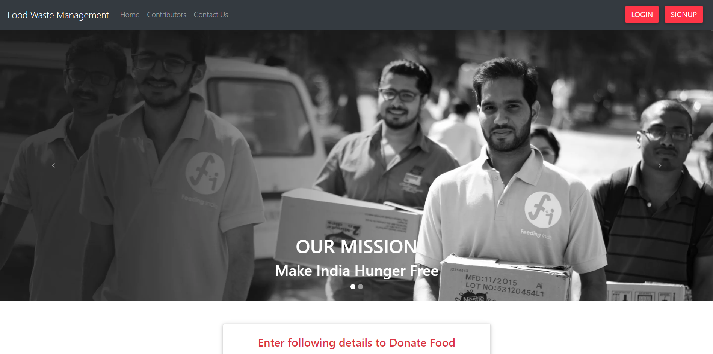
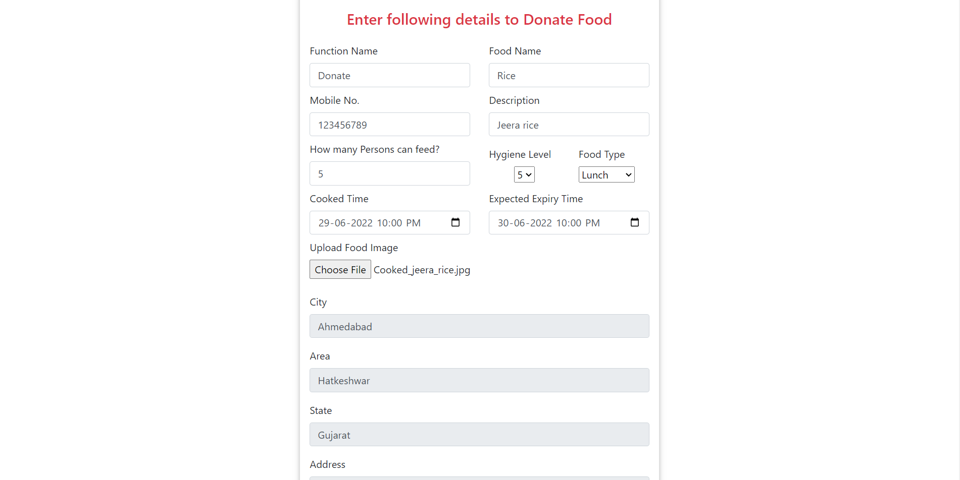

Slide 16
Thank You

